Slide 1

Evolution of the Web, web standards, and organizations
Mr. M Safiullah Lecturer
University of Layyah
msafiullah.cs@gmail.com

Slide 2
WHAT IS THE WORLD WIDE WEB?
The World Wide Web is a way of exchanging information between computers on the Internet.
The World Wide Web is the network of pages, images, texts and sounds on the Internet which can be viewed using browser software.
Library - WWW
Road - Internet

Slide 3
The World Wide Web
The World Wide Web, or Web, consists of a worldwide collection of electronic documents (Web pages)
A Web site is a collection of related Web pages and associated items
A Web server is a computer that delivers requested Web pages to your computer

Slide 4
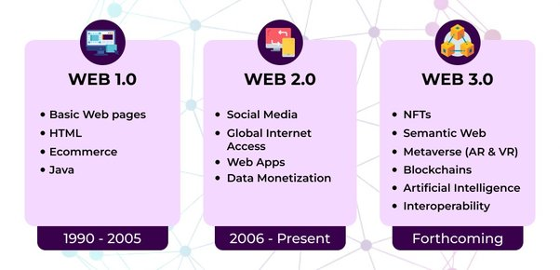
What is the difference between web 1.0, 2.0, 3.0

Slide 5
Web 1.0: Read-only web (like an online newspaper)
Web 2.0: Interactive web (social media, YouTube, e-commerce)
Web 3.0: AI-driven, smart web (chatbots, decentralized apps, AI search engines)
🛠 Real-Life Example:
Web 1.0 = Old Wikipedia pages
Web 2.0 = Facebook, Instagram (you can comment, share)
Web 3.0 = ChatGPT, Voice Assistants, Blockchain websites

Slide 6
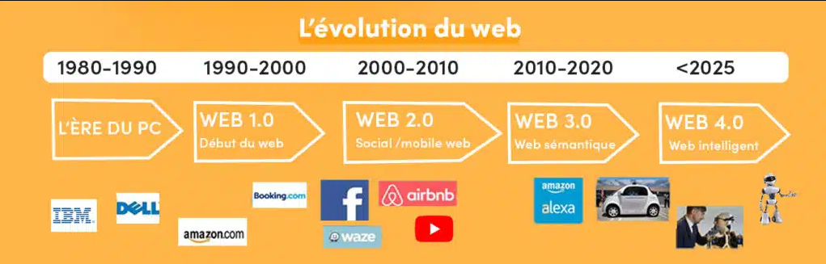

Slide 7
HISTORY
1989-1990 Tim Berners Lee invents the World Wide Web (www) at CERN.
CERN stands for "Conseil Européen pour la Recherche Nucléaire", which is French for "European Council for Nuclear Research."
Published in 1991
http://info.cern.ch/
This means transferring text and graphics simultaneously
Text mark-up language
Simple and easy to use

Slide 8
WWW COMPONENTS
Structural Components
  Clients/browsers - to dominant implementations
  Servers - run on sophisticated hardware
  Caches - many interesting implementations of Internet-the global infrastructure which facilitate data transfer
Semantic Components
  Hyper Text Transfer Protocol (HTTP)
  Hyper Text Markup Language (HTML)
  Extensible Markup Language (XML)
  Uniform Resource Identifiers (URIs)

Slide 9
The Fundamental concept of the World Wide Web
The Hypertext concept
Hypertext is a text which contains links to other texts. The term was coined by Ted Nelson around 1965.
The Hypermedia concept
Hypermedia is a term used for hypertext that is not constrained to be text: it can include graphics, video, and sound

Slide 10
WEB Browser
  A web browser displays a web document and enables users to access web documents.
WEB Server
  This is a program that waits patiently for the browser to request a web page. The server looks for the requested information, retrieves it, and sends it to the browser or sends an error message if the file is not found.
Uniform Resource Locator (URL)
  These are the web addresses. The resource locator is an addressing system.

Slide 11
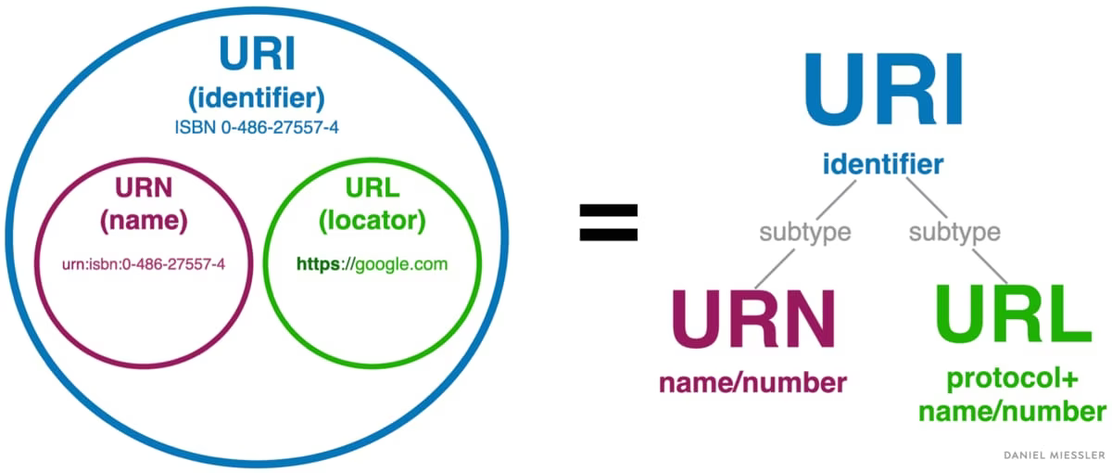

Slide 12
URL and URI
URL (Uniform Resource Locator) = The full address of a website (e.g., https://www.google.com).
URI (Uniform Resource Identifier) = A broader term that includes URLs and other types
of resource identifiers.
🛠 Real-Life Example:
URL = Your home address (specific)
URI = Your name (a unique identifier but not a full address).
Use a house analogy (URL = house address, URI = owner’s name).

Slide 13
How To Create A Web Page?
The two basic steps required in making a web page.
Create an HTML File
Upload a file to the server

Slide 14
Creating a WEB PAGE!
Web pages are generally sets of text files coded with special notation called Hypertext Markup Language (HTML) that is interpreted by a web browser program reading the file.

Slide 15
Which came first Internet or WWW?
The internet came first.
Internet and WWW are two different concepts.
The Internet is a global computer network made up of thousands of computers & computer networks.
WWW is a system that is interlinked via the Internet.

Slide 16
INTERNET AND WWW
Internet
  The Internet is a global system of interconnected computer networks.
  A massive network of networks. These computers communicate with each other using a common protocol (TCP/IP i.e. Transmission Control Protocol/Internet protocol
World Wide Web (WWW)
  WWW is one of the services running on the internet.
  WWW is a system of interlinked hypertext documents accessed via the Internet. Way of accessing the information.

Slide 17
🛠 Real-Life Example:
Internet = Electricity
WWW = A lightbulb that runs on electricity

Slide 18
List of Web Browsers
Google
Mozilla Firefox
Apple Safari
Microsoft Edge
Opera

Slide 19
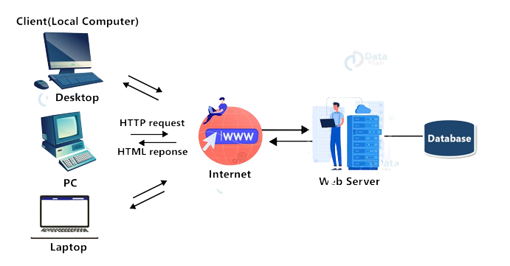
Web Browsers Working

Slide 20
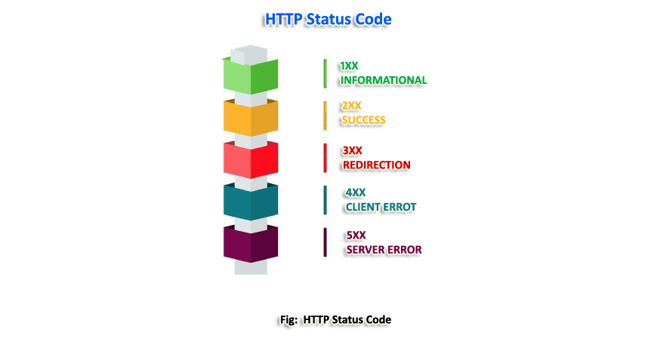
HTTP Response/ Status Code

Slide 21
Types of Search Tools
There are two types of search tools
                Manually curated lists of websites categorized by topics by librarian, Yahoo Directory (discontinued)
Search
Engine
Tools Find information related to a specific topic
Subject
Directory
Classifies Web pages in an organized set of categories

Slide 22
Types of Websites
Personal websites
Blog
Social networking websites
News websites
Educational websites
Government websites
Nonprofit websites
Entertainment websites

Slide 23
The World Wide Web
Web publishing is the development and maintenance of Web pages
Plan a Web site
Analyze and Design a Website
Create a Website
Deploy a Website
Maintain a Website

Slide 24
Summary
WWW is a way of exchanging information.
  Tim Berners Lee invents the World Wide Web (www) at CERN.
  WWW is constructed using HTML
  There are basic steps to create Web pages
  Internet and WWW are two different concepts.
WWW is one of the services that run on the internet.

Slide 25
QUESTIONS???
Who is the inventor of WWW?
1. Charles Babbage
2. Tim Berners
3. Norman Abramson
4. Jack Nilles

Slide 26
Questions
Is there a difference between WWW and Internet?
Which came first Internet or WWW?

Slide 27
Questions
The thing which finds information related to specific topics is called
1. Search Engine
2. Subject directory

Slide 28
Questions
▸ Web page is created using?
1. HTML
2. http
3. URL
4. Web Browser

Slide 29
Answers
Tim Berners
Yes, the two terms are not synonymous. The Internet and the Web are two separate but related things. WWW is a way of accessing information over the Internet.
> Internet
> Search Engine
> HTML

Slide 30
URI
URI stands for Uniform Resource Identifier, and it is a string of characters that provides a unique identifier for a resource on the internet. A URI can be used to identify any type of resource, including web pages, images, video files, and more.

Slide 31
A URI Consists of Two Parts
Scheme
  The scheme identifies the protocol that is used to access the resource, such as HTTP for a web page or FTP for a file transfer.
Path
  The path specifies the location of the resource on the internet, such as the domain name and directory path for a web page.

Slide 32
There are Two Types of URIs
URLs (Uniform Resource Locators)
URNs (Uniform Resource Names).

Slide 33
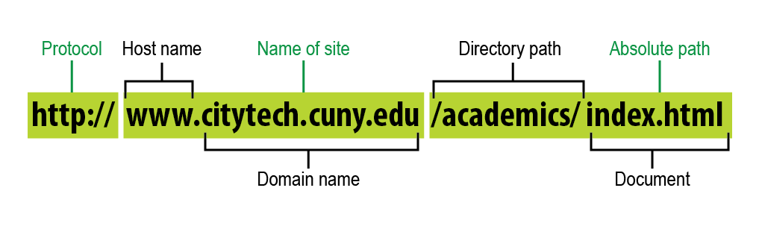
URL
URLs are the most common type of URI and provide a specific location for a resource.

Slide 34
URNs
provide a unique name for a resource but do not specify its location.
urn:<nid>:<nss></nss></nid>
Namespace identifier (NID)
Namespace-specific string (NSS)

Slide 35
Difference Between URL and URN
Feature | URL (Uniform Resource Locator) | URN (Uniform Resource Name)
Purpose | Specifies where a resource is and how to access it | Specifies what a resource is, without location details
Example | https://example.com/book.pdf (Points to an online document) | urn:isbn:0451450523 (Identifies a book by ISBN, but does not tell where to find it)
Changes? | Can change if the resource moves to a new location | Remains constant, even if the resource moves

